Slide 1

By
Sreekala Menon

Slide 2




Slide 3



Slide 4



Slide 5



Slide 6
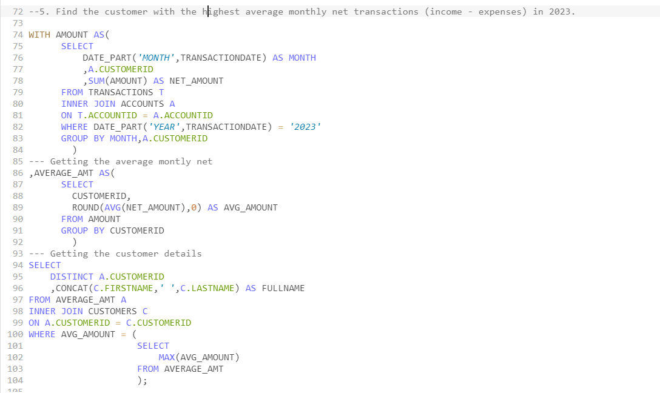

Slide 7
